Slide 1
Topics in Software Engineering
Group Members
KHADIJA BUTT FA19-BSE-045
AMEENA HAMEED FA19-BSE-027
ARSALAN ASIF FA19-BSE-116
Presented To
Ma’am Fatima Sabir

Slide 2
Outline
Background
Problem Statement (Questions )
Proposed Solution
Experiments (Screenshots)
Results
Accuracy
References

Slide 3
Background:
For this problem we have generated the documentation that have class diagram and AST.
With the help of “Jira” we have assigned each role duties and tasks.
Updated the Sprint for new tasks. Updated the cities class to the province class.

Slide 4
Problem Statement
The project task distribution among team members is not allocated and the company wants to revise the application and assign the new tasks among team members that should be completed in three different sprints and each sprint not consist of more than 16 days. Total completion of the project is 45 days or 1.5 months. You need to perform the following operations
Update the Cities class to the Province class and add two provinces and shift the cities to its relevant provinces .

Slide 5
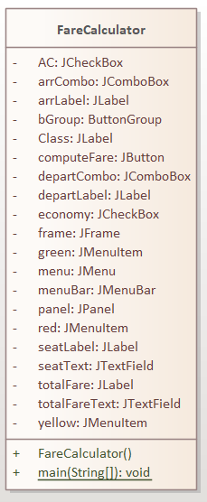
Proposed Solution
Class Diagram

Slide 6
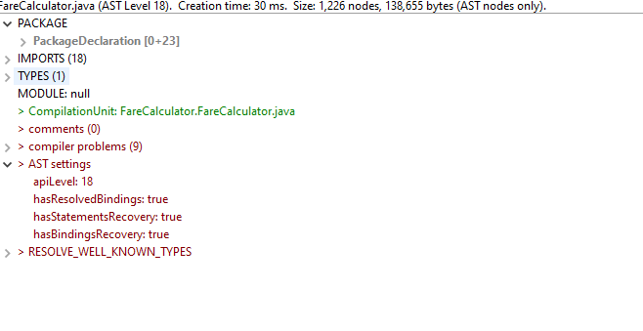
Proposed Solution
AST

Slide 7
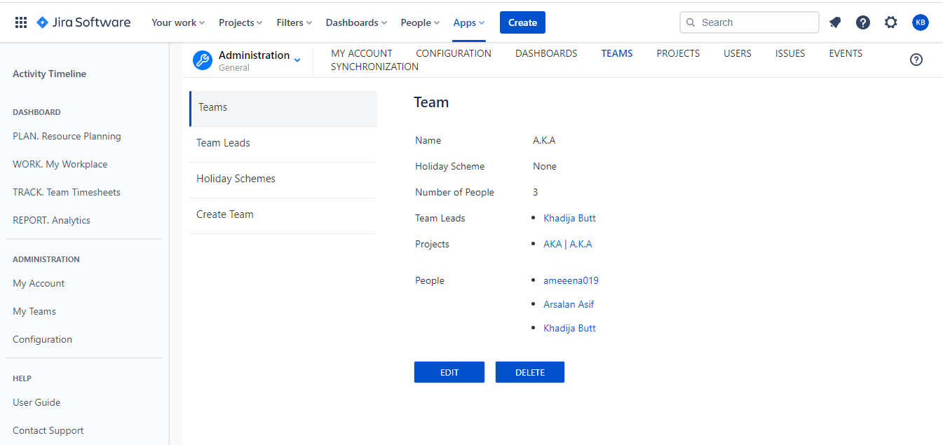
Experiments: Jira

Slide 8
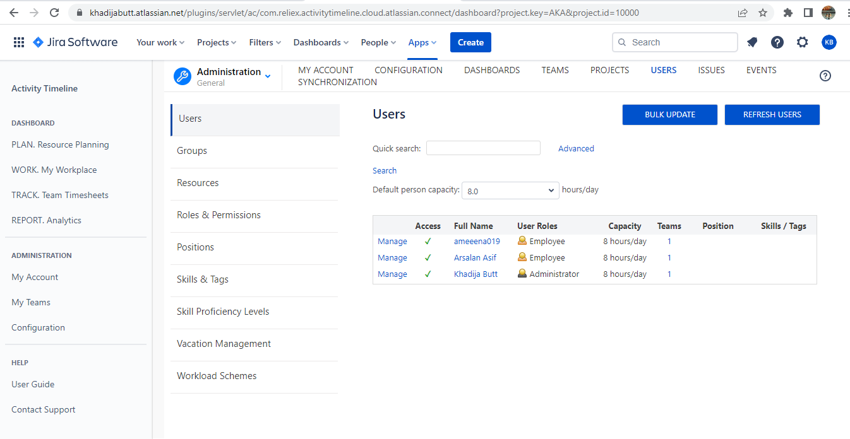
Jira

Slide 9
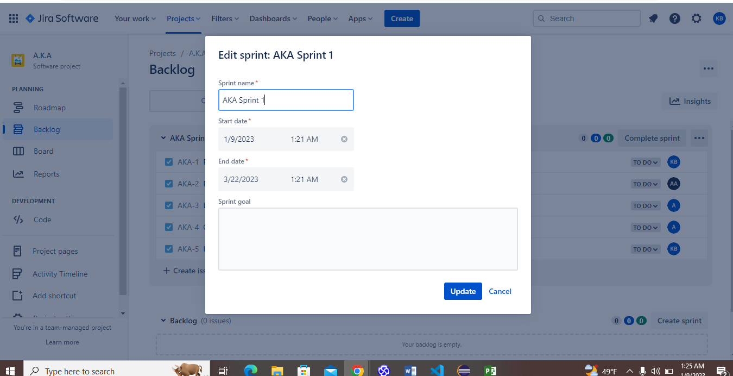
Jira

Slide 10
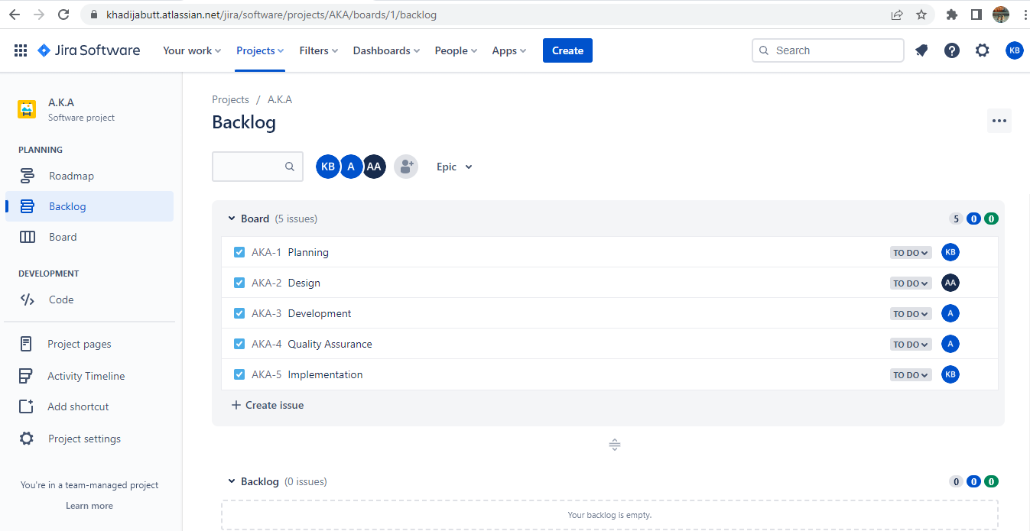
Jira

Slide 11
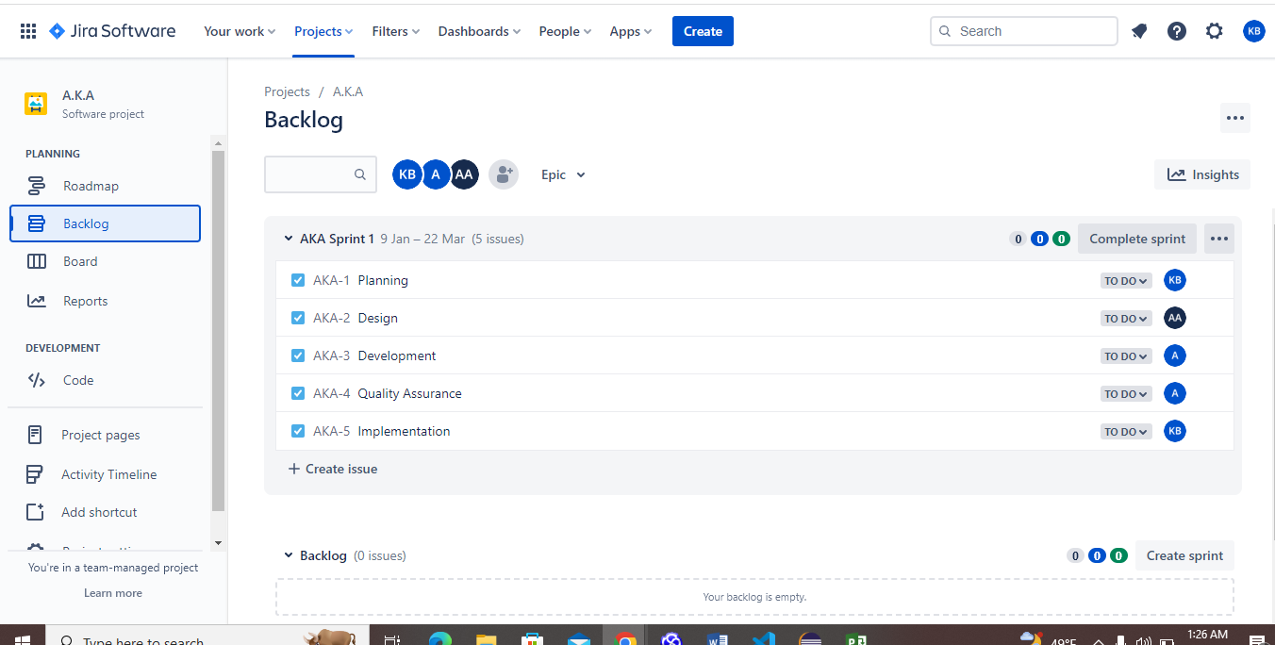
Jira

Slide 12
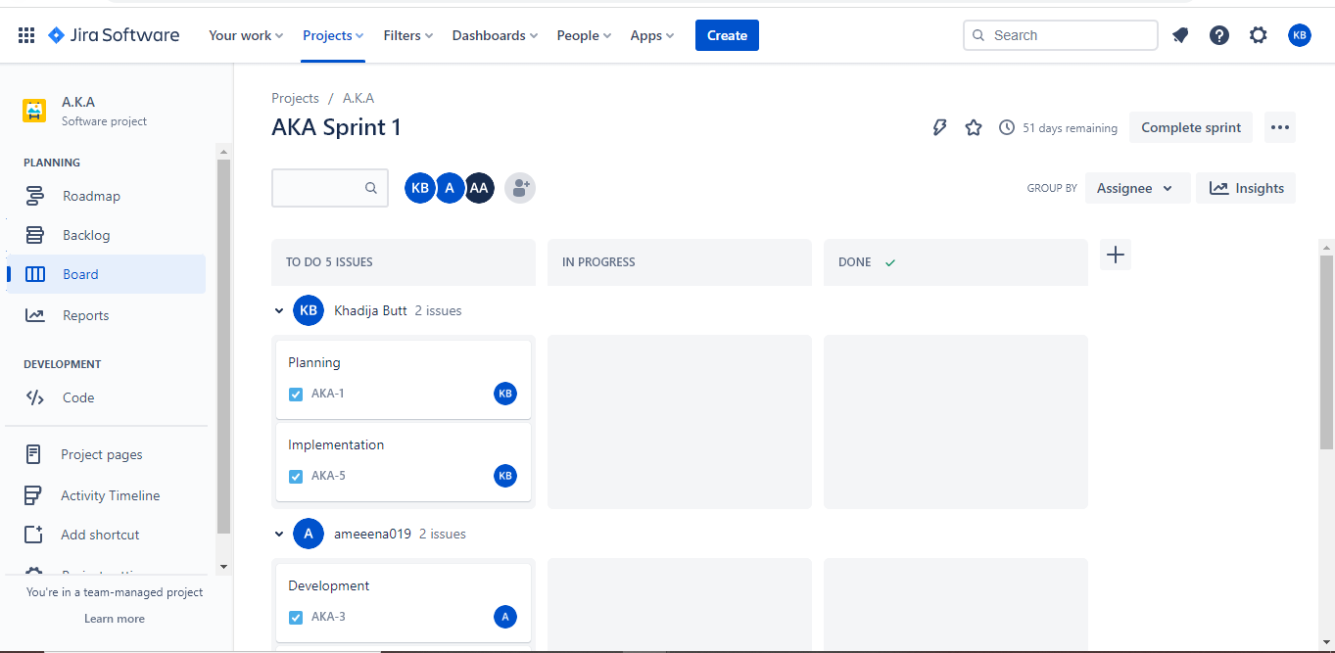
Jira

Slide 13
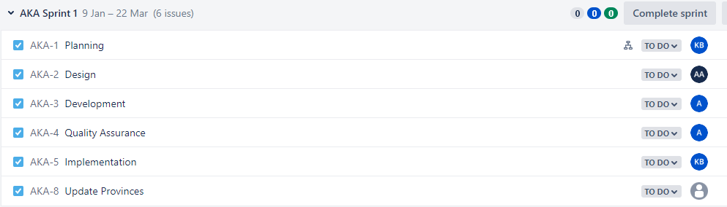
Jira

Slide 14
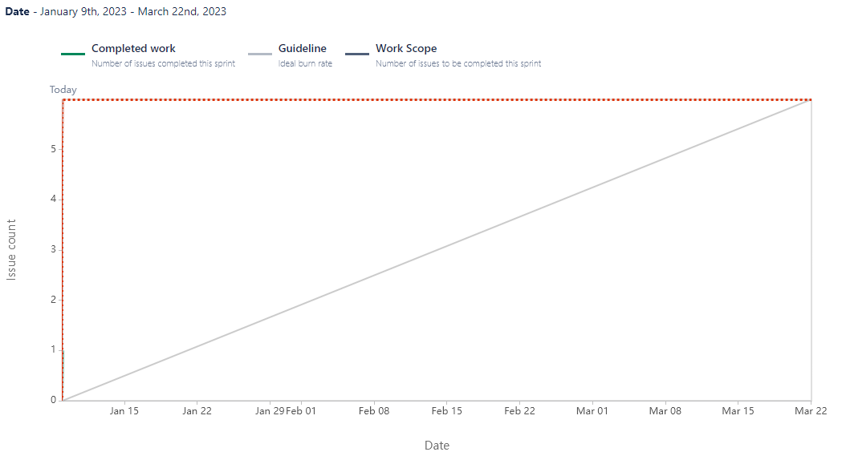
Results: Report

Slide 15
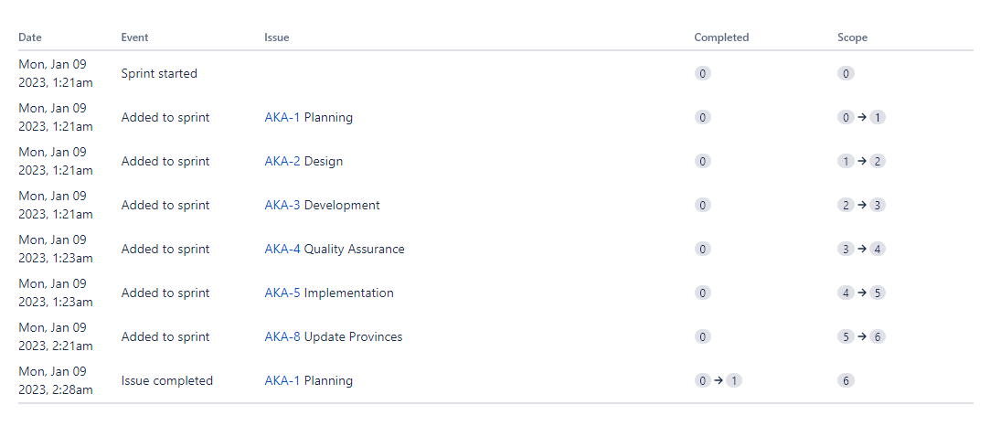
Report

Slide 16
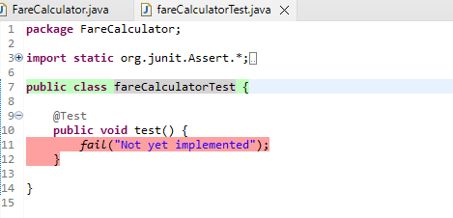
JUnit Test

Slide 17
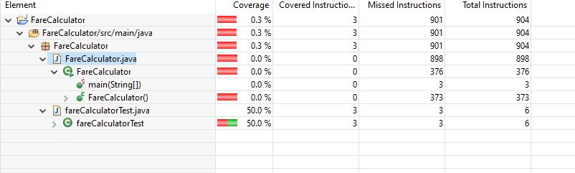
Code Coverage

Slide 18
Tools
Jira
Sparx
Eclipse

Slide 19
References
https://www.atlassian.com/software/jira https://www.eclipse.org/downloads/ https://sparxsystems.com/

